Slide 1
Chapter 7 Software Maintenance
CCSW 325 (Software Construction)
Notes:
Last Update: 22/8/2019
Version 1.0

Slide 2
Outline
Software maintenance

Slide 3

Software Maintenance
Modifying a program after it has been put into use.

Slide 4
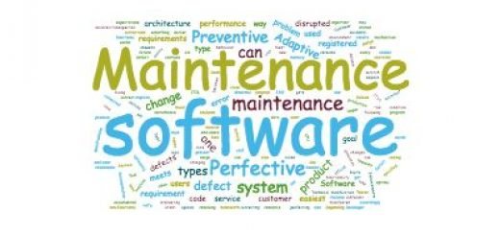
Software Maintenance
Maintenance does not normally involve major changes to the system’s architecture.
Changes are implemented by modifying existing components and adding new components to the system.

Slide 5
Types of Maintenance
Fault repairs
Changing a system to fix bugs/vulnerabilities and correct deficiencies in the way meets its requirements.
Environmental adaptation
Maintenance to adapt software to a different operating environment
Changing a system so that it operates in a different environment (computer, OS, etc.) from its initial implementation.
Functionality addition and modification
Modifying the system to satisfy new requirements.
Fault repair (24%)
Environmental adaptation (19%)
Functionality addition or modification (58%)

Slide 6
Maintenance Costs
Usually greater than development costs (2* to 100* depending on the application).
Affected by both technical and non-technical factors.
Ageing software can have high support costs (e.g. old languages, compilers etc.).

Slide 7
Maintenance Prediction
Maintenance prediction is concerned with assessing which parts of the system may cause problems and have high maintenance costs
Change acceptance depends on the maintainability of the components affected by the change

Slide 8
Maintenance Prediction
What parts of the system will be the most expensive to maintain?
What parts of the system are most likely to be affected by change requests?
Predicting maintainability
What will be the lifetime maintenance costs of this system?
Predicting system changes
Predicting maintenance costs
What will be the costs of maintaining this system over the next year?
How many change requests can be expected?
Notes:
Non-technical factors encompass changes in user requirements, market conditions, and legal or regulatory developments.

Slide 9
Software Reengineering
Restructuring or rewriting part or all of a legacy system without changing its functionality.
Applicable where some but not all sub-systems of a larger system require frequent maintenance.
Reengineering involves adding effort to make them easier to maintain.
The system may be re-structured and re-documented.

Slide 10
Advantages of Reengineering
Reduced risk
There is a high risk in new software development. There may be development problems, staffing problems and specification problems.
Reduced cost
The cost of re-engineering is often significantly less than the costs of developing new software.

Slide 11
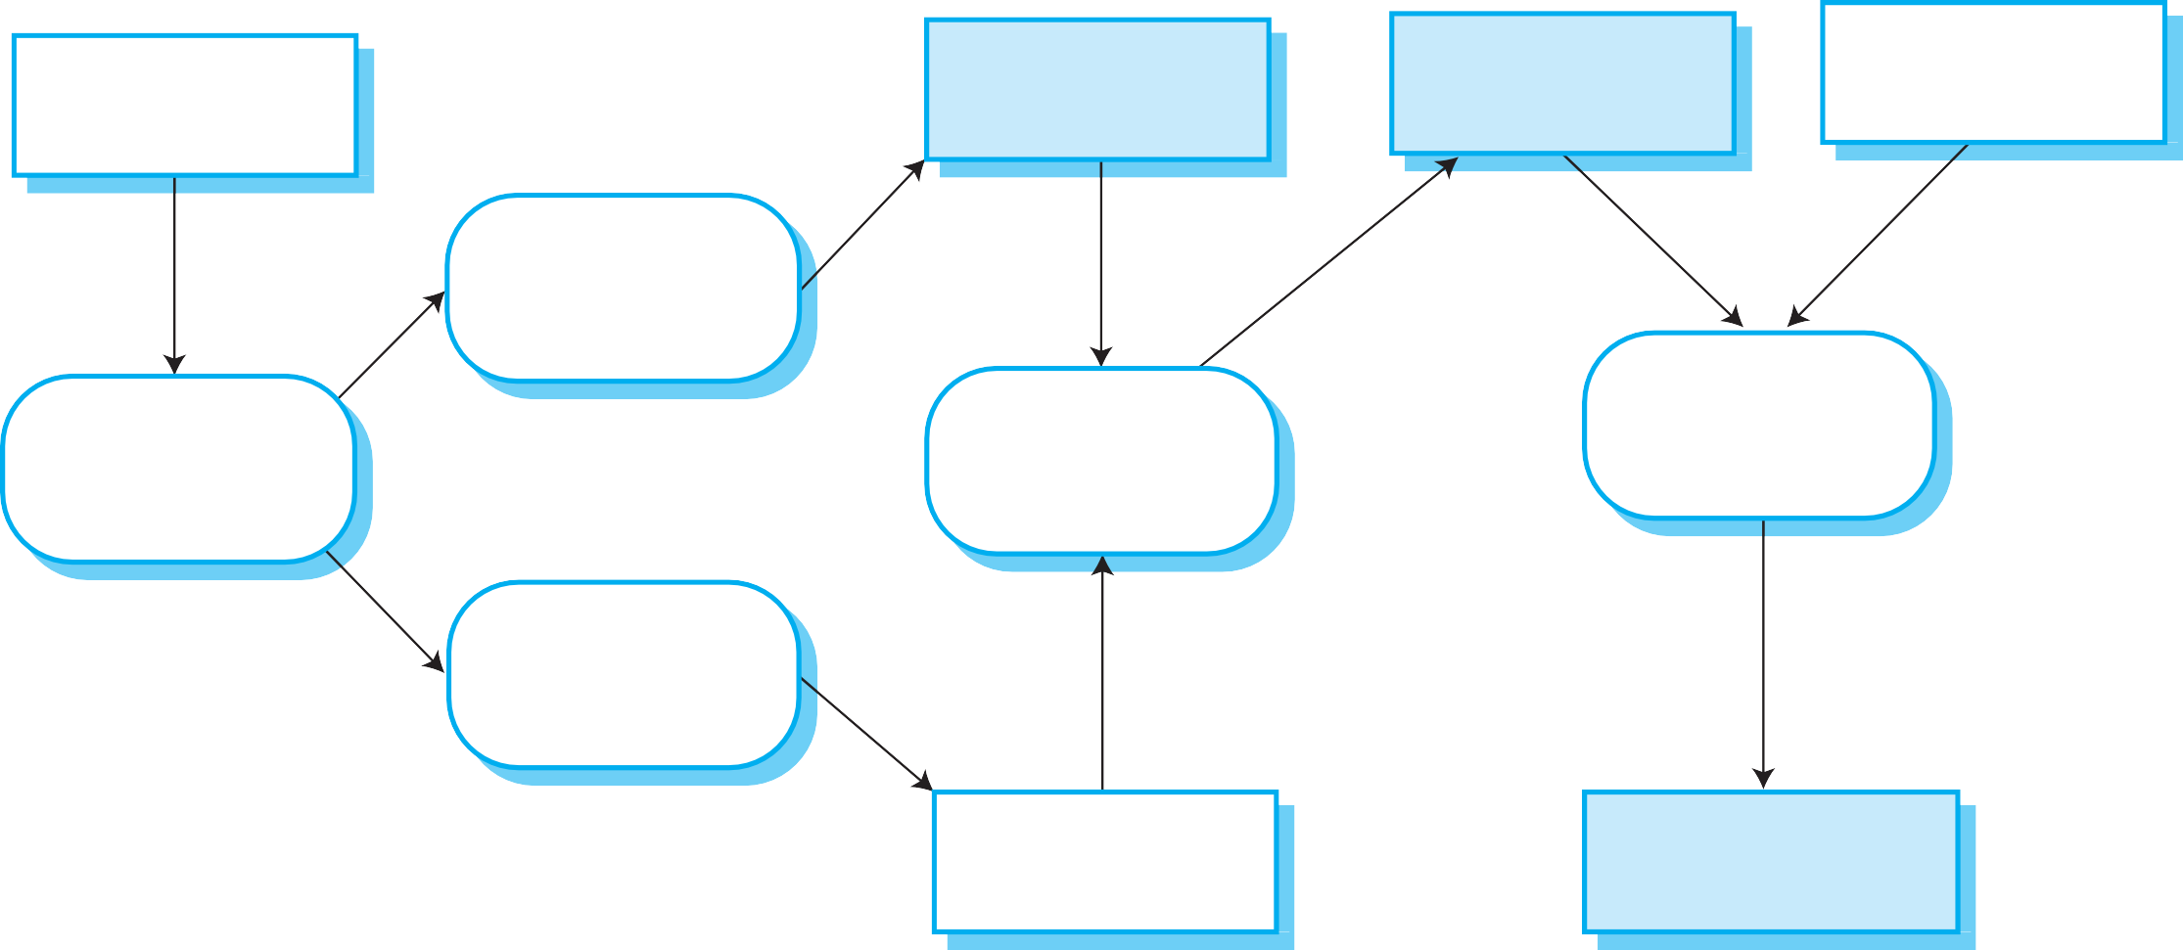
The Reengineering Process
Original program
Program documentation
Re-engineered program
Original data
Reverse engineering
Data reengineering
Source code translation
Analyze the program to understand it
Program modularization
Clean-up and restructure system data
Convert code to a new language
Program structure improvement
Restructure automatically for understandability
Reorganize the program structure
Restructured program
Reengineered data

Slide 12
Reengineering Cost Factors
The quality of the software to be reengineered.
The tool support available for reengineering.
The availability of expert staff for reengineering.
This can be a problem with old systems based on technology that is no longer widely used.

Slide 13
Refactoring
Refactoring is the process of making improvements to a program to slow down degradation through change.
Refactoring involves modifying a program to improve its structure, reduce its complexity or make it easier to understand.
When you re-factor a program, you should not add functionality but rather concentrate on program improvement.

Slide 14
Refactoring and Reengineering
Re-engineering takes place after a system has been maintained for some time and maintenance costs are increasing.
You use automated tools to process and re-engineer a legacy system to create a new system that is more maintainable.
Refactoring is a continuous process of improvement throughout the development and evolution process.
It is intended to avoid the structure and code degradation that increases the costs and difficulties of maintaining a system.

Slide 15

“Bad Smells” in program code

Slide 16
“Bad Smells” in program code
Duplicate code
The same or very similar code may be included at different places in a program.
This can be removed and implemented as a single method or function that is called as required.
Long methods
If a method is too long, it should be redesigned as a number of shorter methods.

Slide 17
“Bad Smells” in program code
Switch (case) statements
These often involve duplication, where the switch depends on the type of a value.
The switch statements may be scattered around a program. In object-oriented languages, you can often use polymorphism to achieve the same thing.

Slide 18
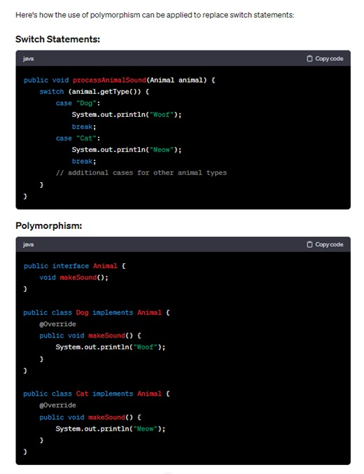

Slide 19
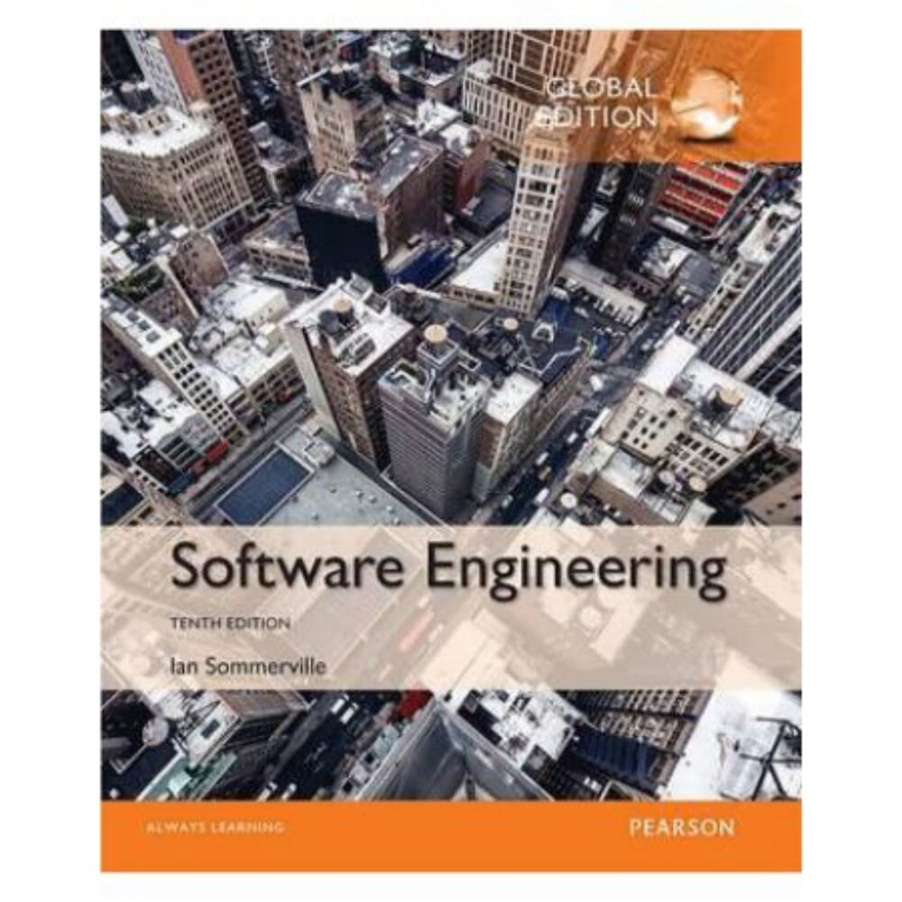
Reading
Software Engineering 10th Edition, Ian Somerville
Chapter 9

Slide 20

Any questions? ​
Please feel free to raise your hands and ask.

